Slide 1
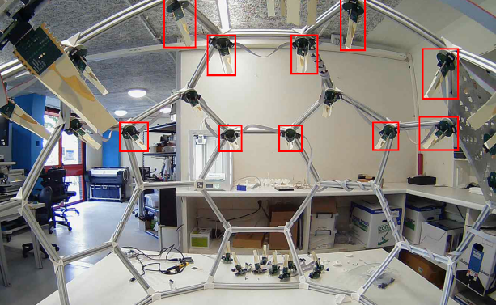
ADome GUI

Slide 2
Content
Adome project
GUI Systemarchitecture
GUI Requirements
Schedule
Current state
Current and future tasks
Possible obstacles

Slide 3
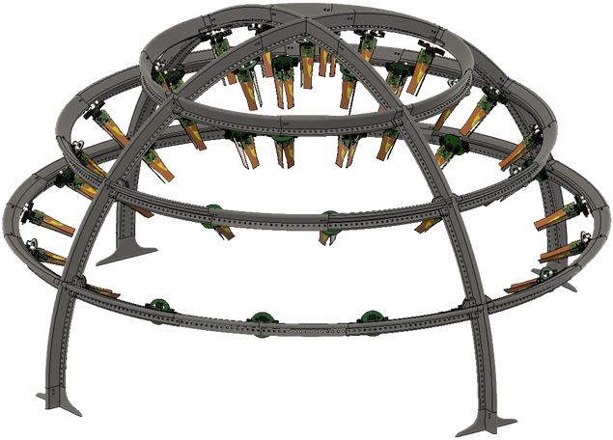
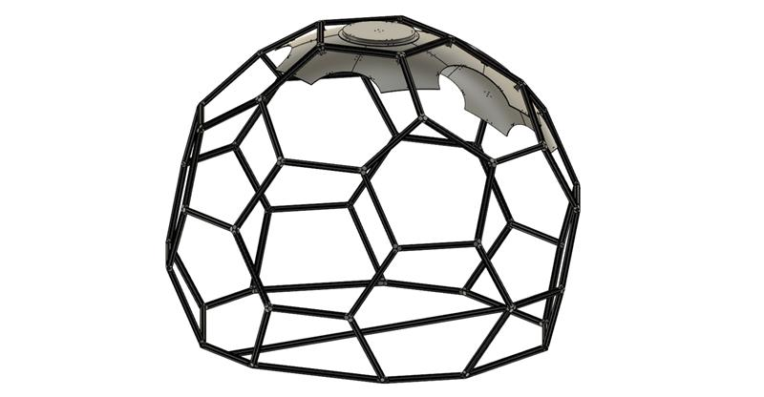
ADome project
ADome
Optical Calibration System (OCS)
CAN bus

Slide 4
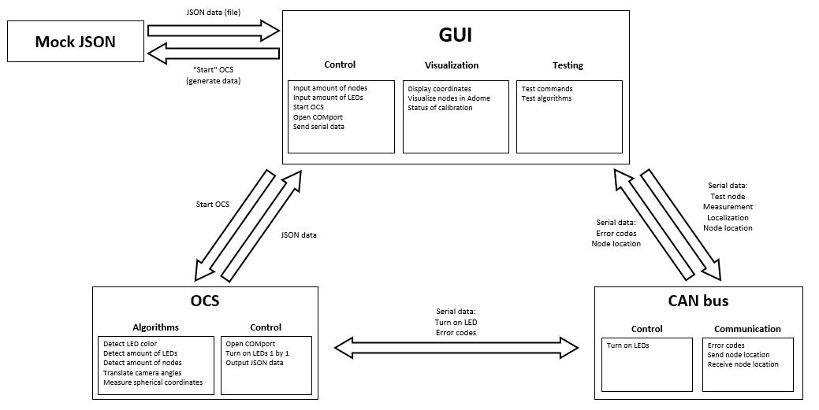
GUI Systemarchitecture

Slide 5
GUI Requirements
GUI
Input amount of measuring nodes. (Must)
Start button. (Must)
Show the coordinates of nodes. (Must)
Text box for user feedback from the GUI (error codes etc.. (Must)
Node testing commands. (Should)
Visualize nodes in a polar or spherical coordinate model of the ADome. (Should)
Command interface for sending serial data to CAN bus. (Could)
Show orientation of the nodes. (Could)
Visualize nodes in a 3D model of the ADome. (Could)
Algorithms
Turn on a combination of four LEDs one by one with OCS. (Must)
Call OCS three times for different positions of the camera within the ADome by pressing a button. (Must)
Write a mock function that creates JSON test input and output data, so it corresponds to the actual data from the OCS. (Must)
Write a function that displays the generated JSON data. (Must)
Compare the amount of nodes found by OCS against the amount of nodes declared in the GUI. (Must)
Write back the coordinates of the node to that specific node with CAN bus. (Could)
Call OCS three times for different positions of the camera within the ADome automatically. (Could)
Retrieve the coordinates from the nodes with CAN bus. (Could)
Determine orientation of the nodes. (Could)
Translate the position of the camera to the middle of the dome. (Won’t)

Slide 6
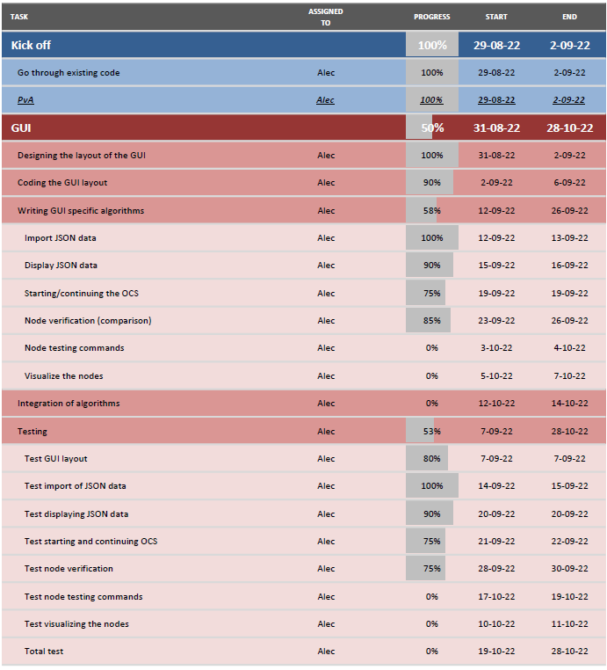
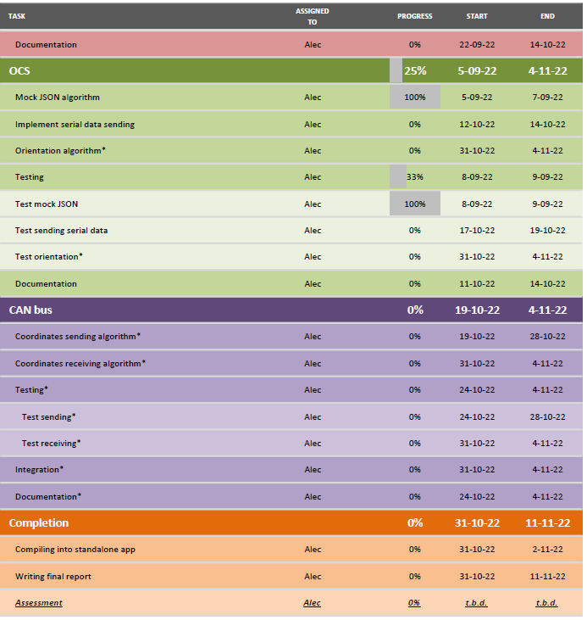
Schedule (progression)

Slide 7
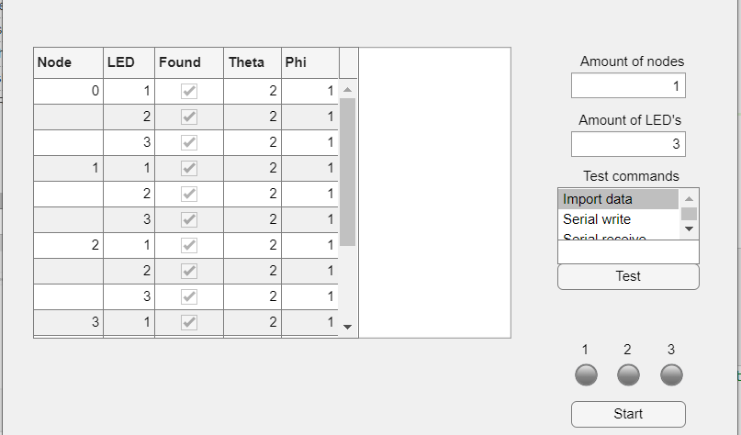
Current state of the GUI
GitHub
Starting OCS multiple times, verifying and displaying data.
Displaying data from the command window i.e. error codes and status of the OCS/GUI/CAN bus.
Demonstration

Slide 8
Current and (near) future tasks
Possibility of using timers.
Sending commands from the GUI to CAN bus.
Visualizing the nodes in the GUI.
Documentation

Slide 9
Possible obstacles
The OCS not working/not finished in the testing stage.
CAN bus not working when testing.
Antennas not working when testing.
Integration taking too long.

Slide 10
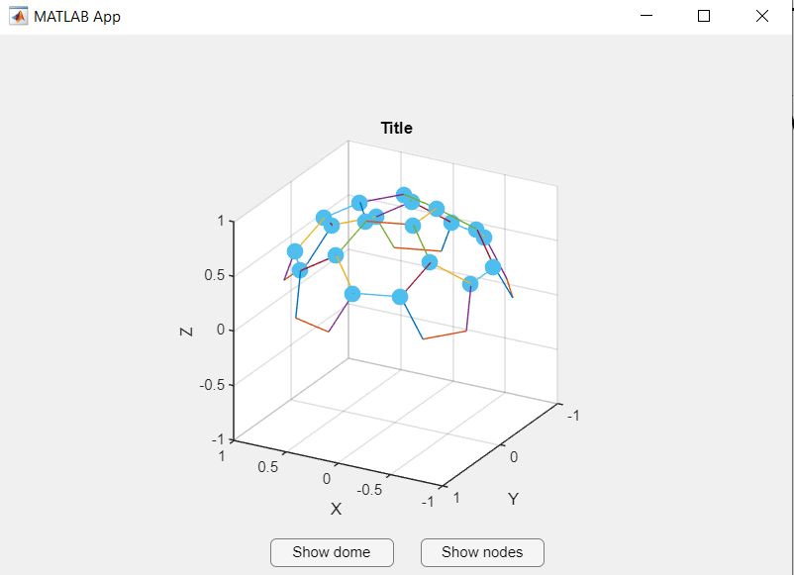
Current state (4-10-2022) visualizing nodes GUI

Slide 11
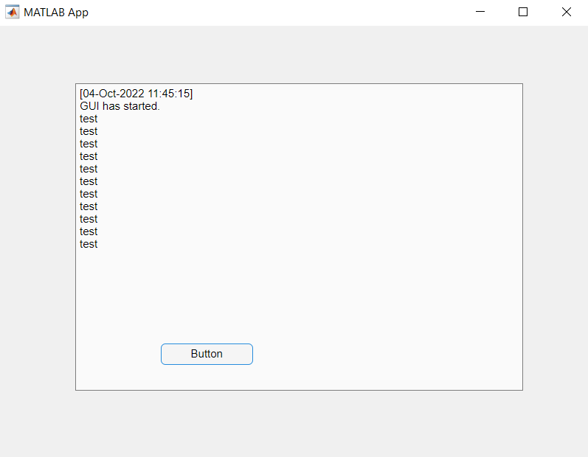
Command window to textbox GUI
Using printf() to send data to command window, then read command window and display it. Using button to repeatedly print “test” in command window and then display it in GUI.

Slide 12
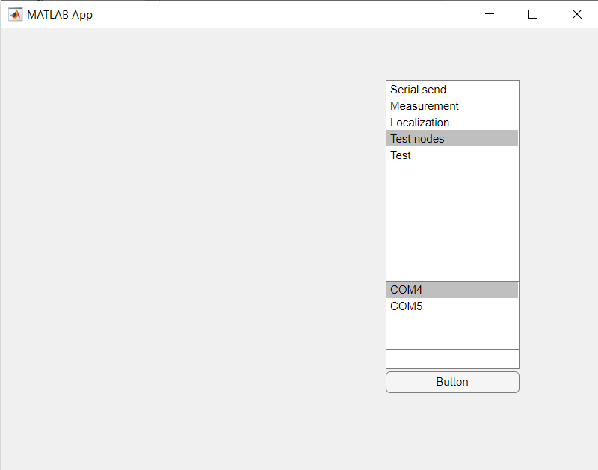
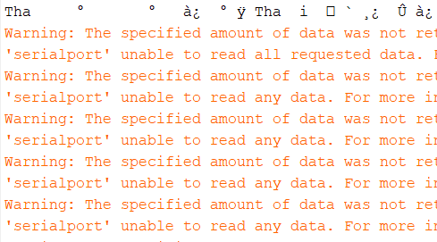
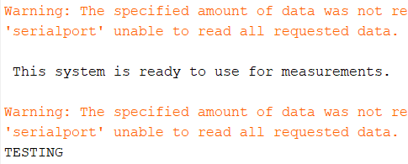
Node commands GUI
The black tekst is output data from the CAN bus master. The warnings are because there is no data to read from the COM port and it is waiting on the master.
After using “test” command (first sending “i” to initiate CAN bus master and then sending “a” to receive “TESTING”

Slide 13
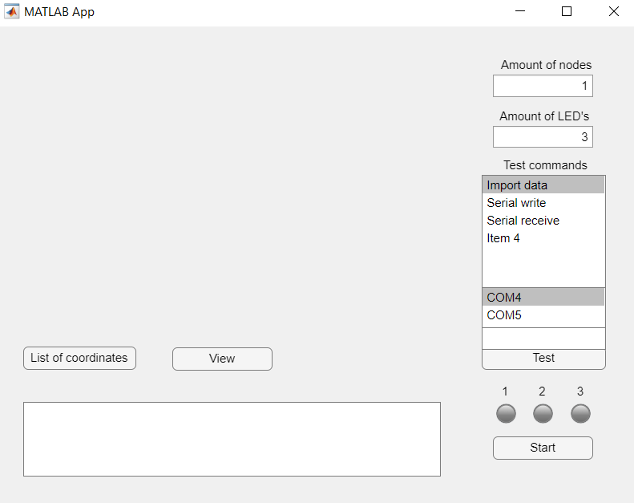
ADome GUI normal state

Slide 14
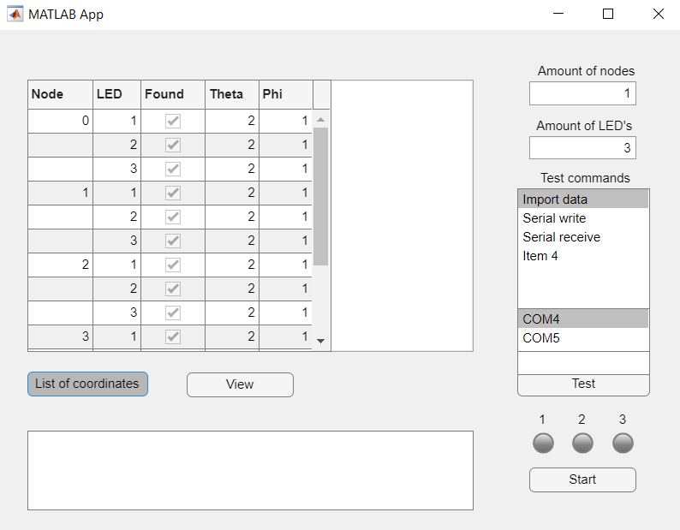
ADome GUI list of coordinates state

Slide 15
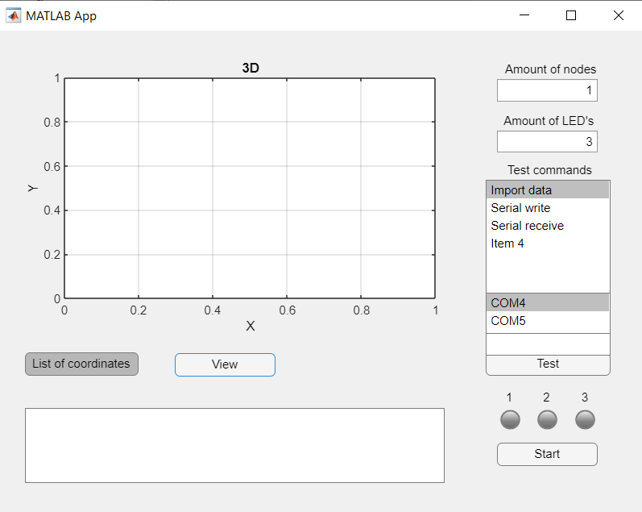
ADome GUI visualize nodes state

Slide 16
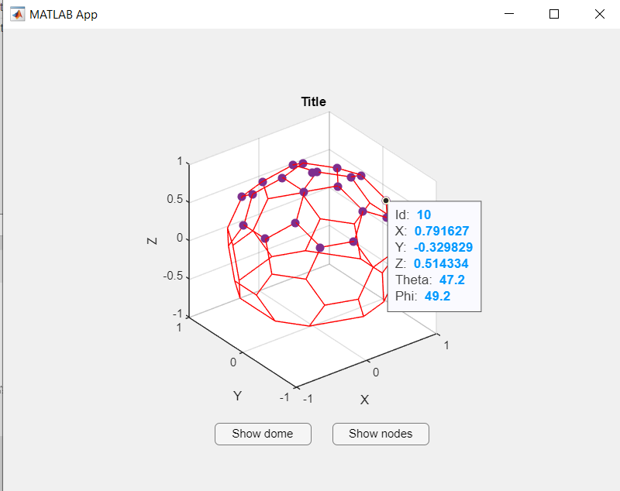
Update (14-10-2022) visualizing nodes GUI

Slide 17
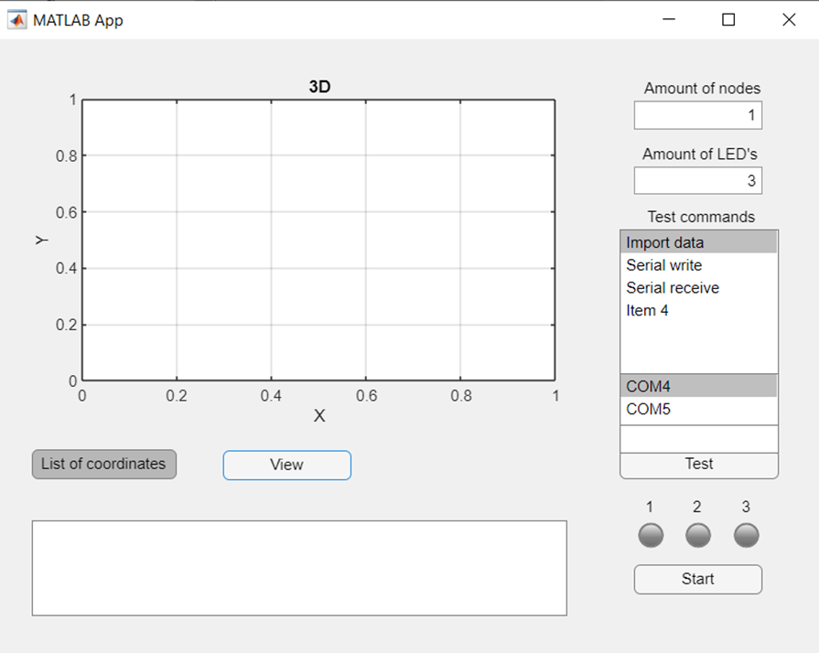
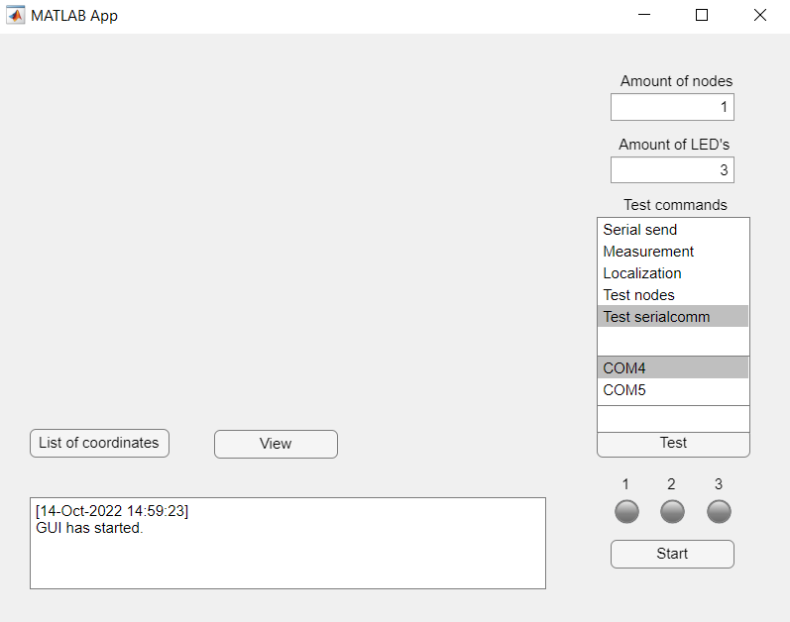
ADome GUI normal state

Slide 18
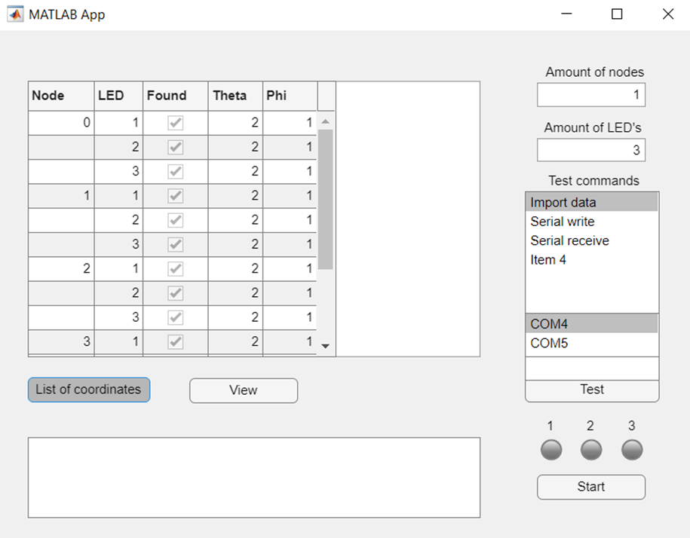
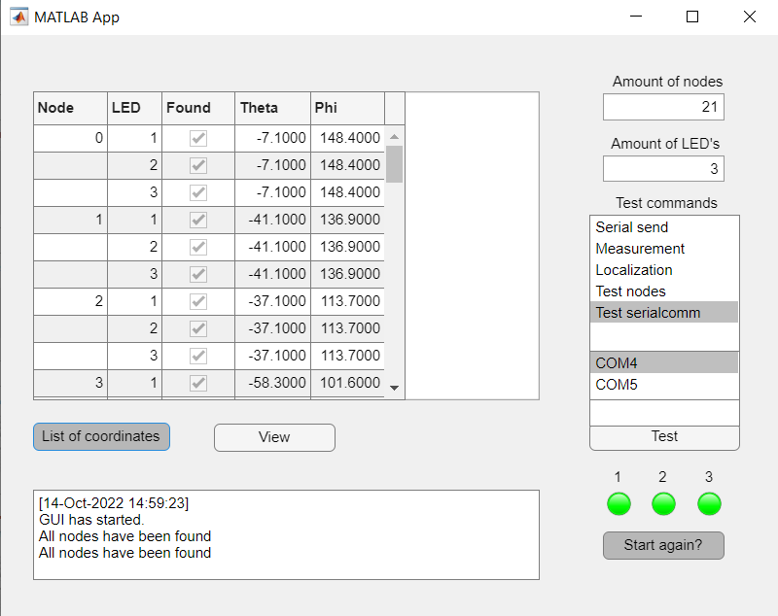
ADome GUI list of coordinates state

Slide 19
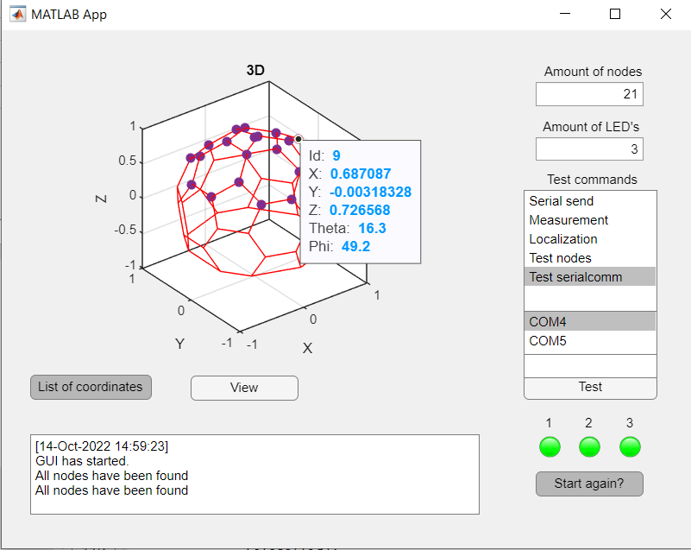
ADome GUI visualize nodes state

Slide 20
GUI Requirements progression 14-10-2022
GUI
A way to manually input amount of measuring nodes with a minimum of 1 and a maximum of 30. (Must have)
A button to start OCS, thus begin measurements and generate data of at least 1 node and 1 LED, with no more than the amount of nodes and LEDs given by first requirement. (Must have)
Display the collected nodes, the LEDs, spherical and Cartesian coordinates and the found status of the LEDs of every node in a list (corresponding to the generated data). (Must have)
Text box for user feedback from the GUI (error codes, function status, etc.). (Must have)
At least 3 buttons (Measurement, Localization, Test node) to send testing commands to the master of the CAN bus. (Should have)
Visualize nodes in a spherical coordinate model of the ADome (corresponding to the generated data). (Should have)
A text box interface for sending user input data to the master of the CAN bus, Must contain any ASCII character before sending. (Could have)
Display a list with the orientation of each node in degrees based off the center of the dome (corresponding to the generated data). (Could have)
Algorithms
Turn on a combination of four LEDs one by one with the OCS software, so it can detect each LED of each node individually and knows which LED belongs to which node. (Must have)
Call OCS three times for different positions of the camera within the ADome by pressing the start OCS button three times. (Must have)
Write a mock function that creates JSON test input and output data, so it corresponds to the actual data from the OCS. (Must have)
Compare the amount of nodes found by OCS against the amount of nodes declared by the user in the GUI to verify if all the nodes have been found. (Must have)
Write back the coordinates of the node to that specific node with serial data and CAN bus. (Could have)
Call OCS three times for different positions of the camera within the ADome automatically, without the need of user interaction after the initial start. (Could have)
Retrieve the coordinates from individual nodes with serial data and CAN bus. (Could have)
Determine the orientation of the nodes based off the coordinates of the four LEDs on the individual nodes. (Could have)
Translate the position of the camera from three relative positions to an absolute position centered in the dome. (Won’t have)
Accomplished
Will not be done
Work in progress

